Slide 1
Coding Club 2021 - Python Session 2
Computer Vision

Slide 2
1
Last Session Assignment Review (10 min)
2
Background and Theories (20 min)
Agenda
3
Coding Time
(60 min)
4
Assignment

Slide 3
Last Session Assignment Review (10 min)
Recap assignment
Sample solution
Q&A

Slide 4

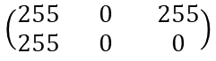
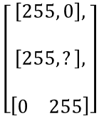
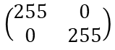
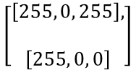
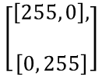
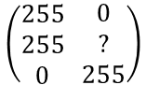
Background and Theories (20 min)
0
255
255
0
255
0
255
0
255
Graphical
255
0
255
255
0
0
?
0
255
Maths
$$\left(\begin{matrix}255 & 0 \\ 0 & 255\end{matrix}\right)$$
$$\left(\begin{matrix}255 \\ 255\end{matrix} \begin{matrix}0 \\ 0\end{matrix} \begin{matrix}255 \\ 0\end{matrix}\right)$$
$$\left(\begin{matrix}255 \\ 255 \\ 0\end{matrix} \begin{matrix}0 \\ ? \\ 255\end{matrix}\right)$$
$$\left[\begin{aligned}\left[255, 0\right], \\ \\ \left[255, ?\right], \\ \\ \left[\begin{matrix}0 & 255\end{matrix}\right]\end{aligned}\right]$$
Python Array
$$\left[\begin{aligned}\left[255, 0\right], \\ \\ \left[0, 255\right]\end{aligned}\right]$$
$$\left[\begin{aligned}\left[255, 0, 255\right], \\ \\ \left[255, 0, 0\right]\end{aligned}\right]$$
Shape
(2,2)
(2,3)
(3,2)
Row by column

Slide 5
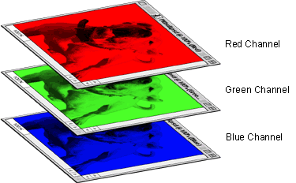
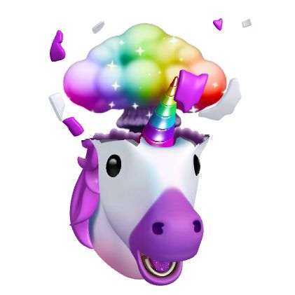
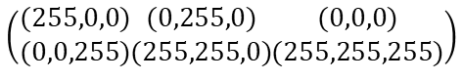
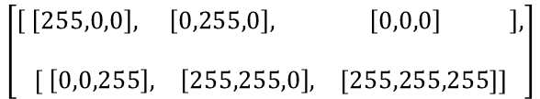
Background and Theories (20 min)
0
255
0
255
0
255
$$\left(\begin{matrix}(255,0,0) \\ (0,0,255)\end{matrix}\begin{matrix}(0,255,0) \\ (255,255,0)\end{matrix}\begin{matrix}(0,0,0) \\ (255,255,255)\end{matrix}\right)$$
(255,0,0)
(0,255,0)
(0,0,0)
(0,0,255)
$$\left[\begin{aligned}\left[ \begin{matrix}\left[255,0,0\right], & \left[0,255,0\right], & \left[0,0,0\right] \end{matrix}\right], \\ \\ \left[\begin{matrix} \left[0,0,255\right], & \left[255,255,0\right], & [255,255,255]\end{matrix}\right]\end{aligned}\right]$$
(255,255,0)
(255,255,255)

Slide 6

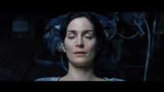

Background and Theories (20 min)
Resize
Convert Colour
Read / Write
Detect
Filter
Display
Manipulation based on academic research
Etc

Slide 7


Background and Theories (20 min)
Read / Write speed
Flexibility to manipulate
Powerful libraries with ongoing supports from community

Slide 8
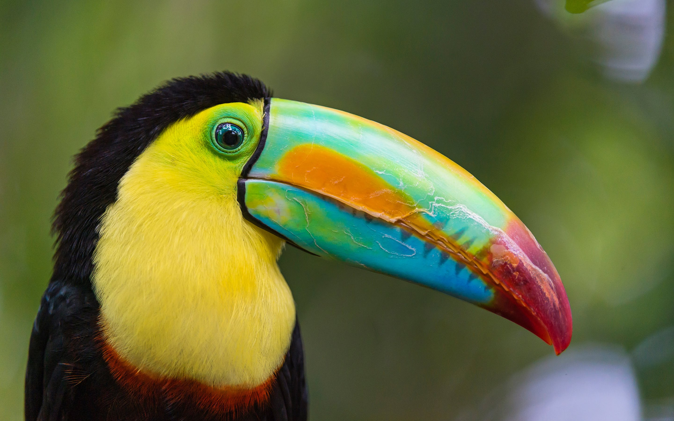
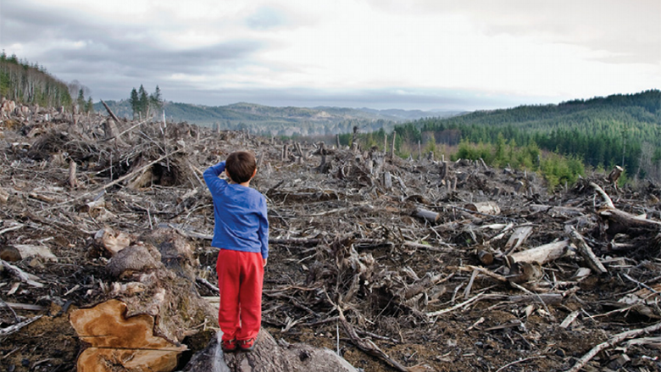
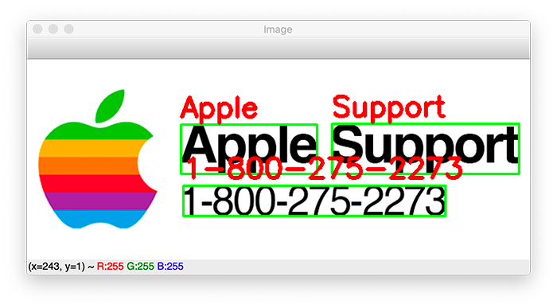
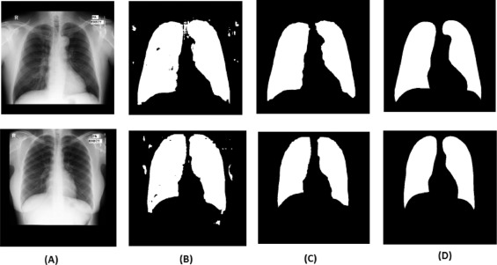
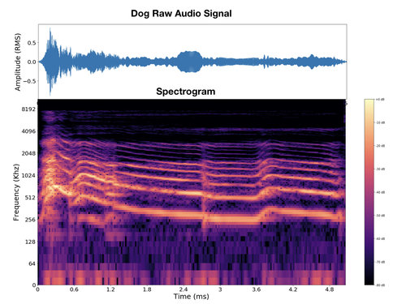
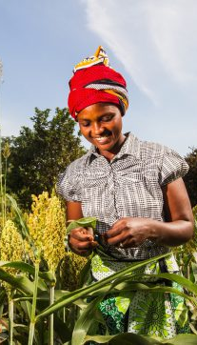
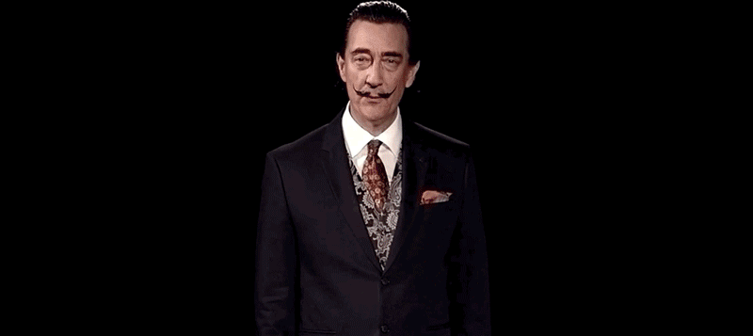

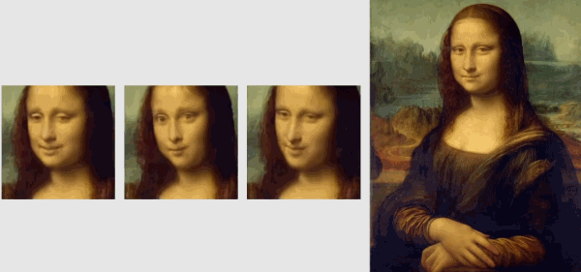
Background and Theories (20 min)
https://thispersondoesnotexist.com/
Notes:
Illegal logging

Slide 9
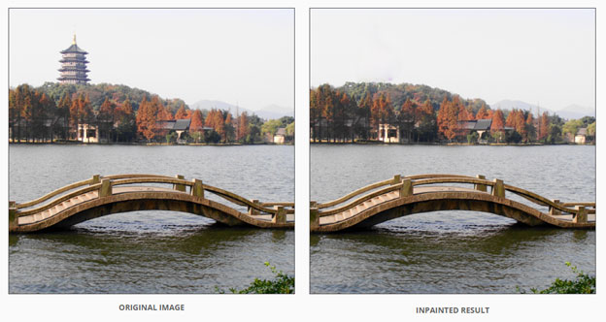
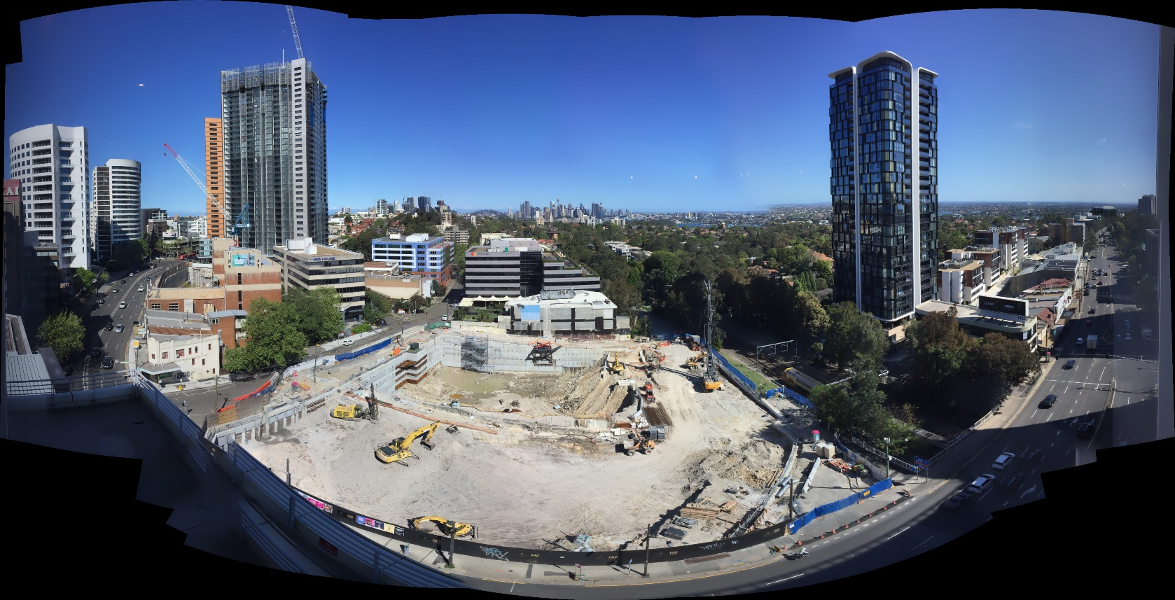
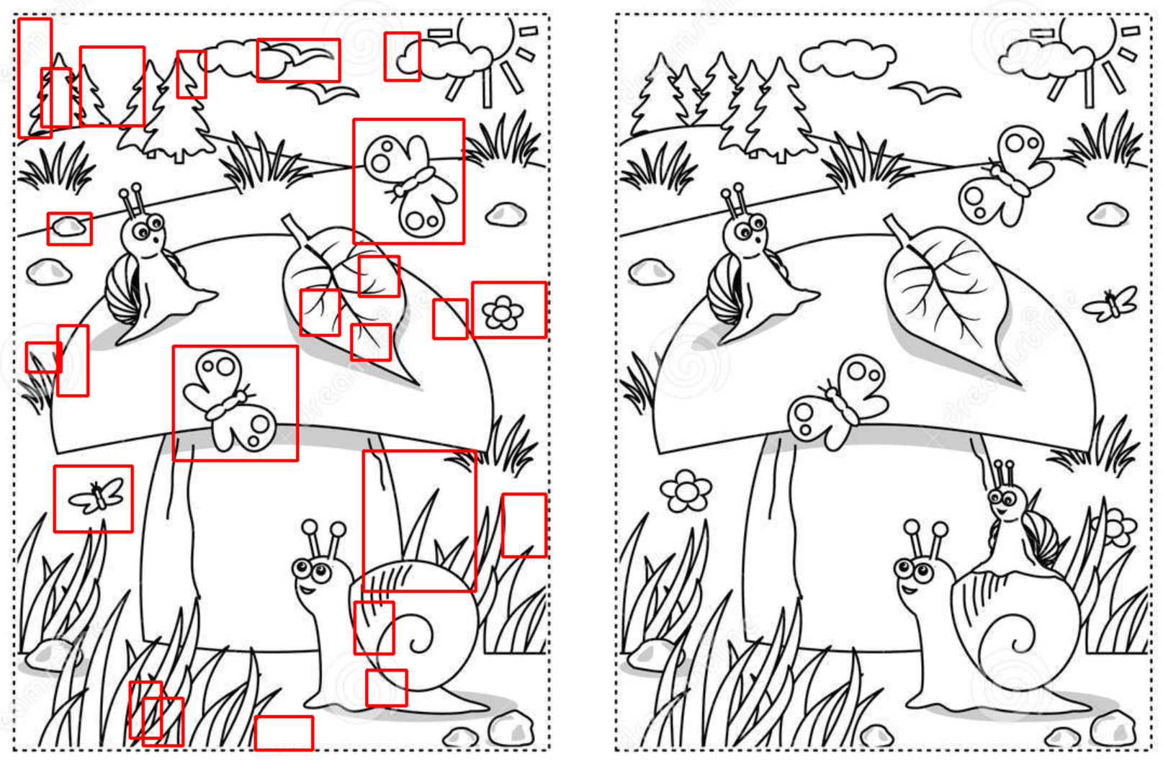
Background and Theories (20 min)

Slide 10
Coding Time (60 min refer to notebook)
Compare images, Restore images, Stitching images
Teaching points
Generic (in case new people join)
Print, input
Shortcut keys, run by row
Code, markdown, notebook and .py
Import library
Tab function and error handling
Session specific
Read from path / file
Display photo / video
Display inline
Numpy
Resize, grayscale
Cropping, draw rectangle
threshold masking
findContours
cvtColor, filter
Export to file

Slide 11
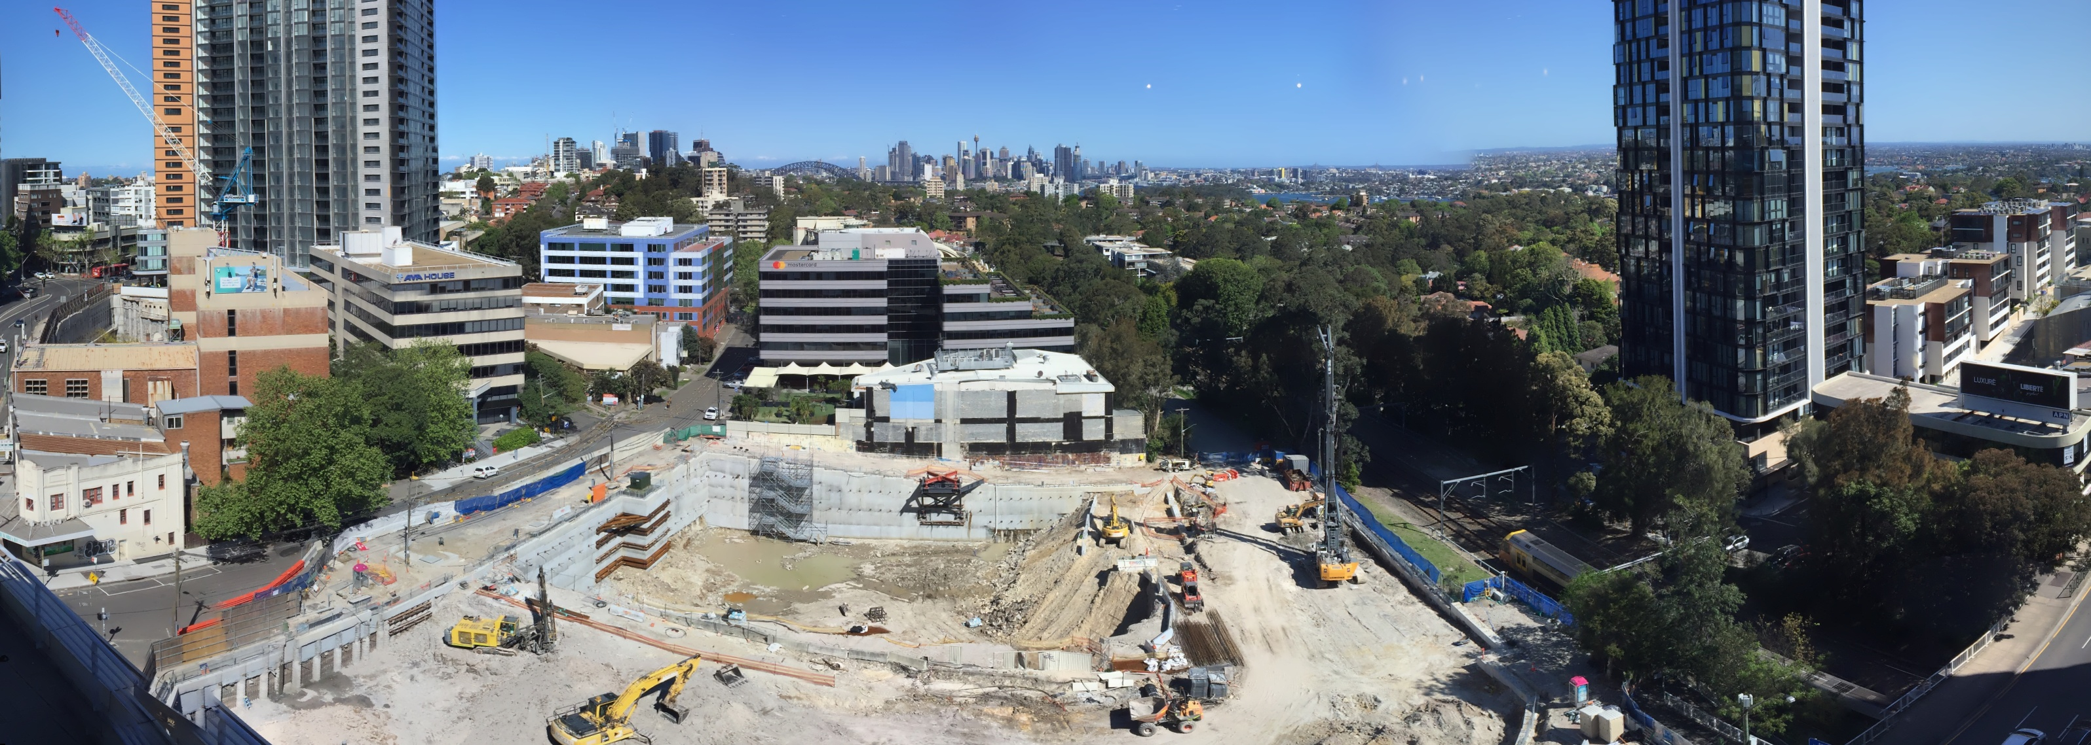
This Session Assignment
Outline process of creating panorama
→
Notes:
Importance of identifying steps in coding process
Start to end many steps, seek answers to each step
Avoid trying to jump to final solution
Steps help debug “step by step”, can try out each step in jupyter
Only required to think of steps involved, use imagination
Full solution will be given next week for takeaway use

